Slide 1
Concentrations of Solutions Molarity
جامعة البصرة– كلية الصيدلة
فرع الكيمياء الصيدلانية – المرحلة الأولى
الكيمياء التحليلية
الأستاذ االدكتور
حسين ناصر السلمان
2025-2024

Slide 2
More Practice
Q.1 How many grams of CuSO₄ are needed to
prepare 250.0 mL of 1.00 M CuSO₄?
Given: 250.0 mL soln
1.00 M CuSO₄
Find: g CuSO₄
Use: mol CuSO4 = molarity x volume
Molarity = mol / 1L
Vol = 250.0 mL

Slide 3
Concentration of Solutions Interconverting Molarity, Moles, and Volume
g CuSO₄ = 250.0 mL soln x 1 L x 1.00 mol
1000 mL 1 L soln
x 159.6 g CuSO₄
1 mol
= 39.9 g CuSO₄

Slide 4
Solution Stoichiometry
Remember: reactions occur on a mole to mole basis.
For pure reactants, we measure reactants using mass
For reactants that are added to a reaction as aqueous solutions, we measure the reactants using volume of solution.

Slide 5
Solution Stoichiometry Practice
Q.2 If 25.0 mL of 2.5 M NaOH are needed to
neutralize (i.e. react completely with) a
solution of H₃PO₄, how many moles of
H₃PO₄ were present in the solution?
Given: 25.0 mL 2.5 M NaOH
balanced eqn: 3 mol NaOH/1 mol H₃PO₄
Find: moles of H₃PO₄
3NaOH (aq) + H₃PO₄ (aq) → Na₃PO₄ (aq) + 3H₂O(l)

Slide 6
Approach
moles
NaOH
Molarity
NaOH
Vol
NaOH Soln
2.5 M (=mol/L)
Molar ratio
0.025 L NaOH soln
3 mol NaOH/1 mol H₃PO₄
moles
H₃PO₄
25.0 mL NaOH soln
1L
2.5 mol
Mol NaOH = 25.0 mL x
x
= 0.0625 /3 =0.02 mol H3PO4
1000 mL
1 L

Slide 7
More practice
Q.3 What mass of aluminum hydroxide is
needed to neutralize 12.5 mL of 0.50 M
sulfuric acid?
Next slide

Slide 8
2Al(OH)3 + 3H2SO4 = Al2(SO4)3 + 6H2O
n = M X V (L)
0.5 M X 0.0125 L = 0.00625 mole ( acid)
2/3 x 0.00625 = 0.00416 mole , Al(OH)3
W = n x M Wt. = 0.00416 x 78 g/mol.= 0.37 g

Slide 9
Solution Stoichiometry
Solution stoichiometry can be used to determine the concentration of aqueous solutions used in reactions.
Concentration of an acid can be determined using a process called titration.
reacting a known volume of the acid with a known volume of a standard base solution (i.e. a base whose concentration is known)

Slide 10
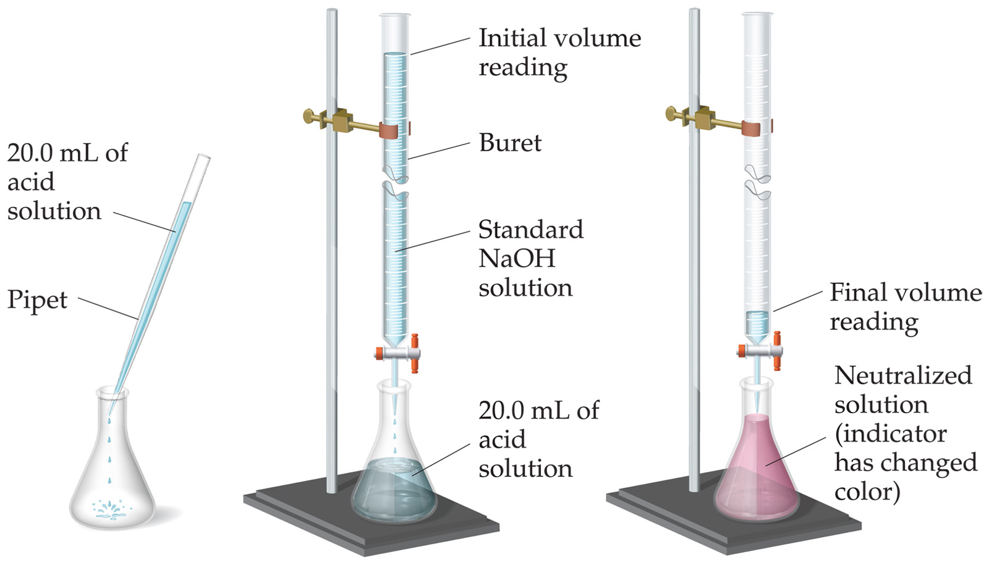
Titration

Slide 11
Practice
Q.4 If 35.50 mL of 2.5 M NaOH are needed to
neutralize 50.0 mL of an H₃PO₄ solution,
what is the concentration(molarity) of the
H₃PO₄ solution?
Given: 35.50 mL 2.5 M NaOH
50.0 mL of H₃PO₄ sol’n
Find: molarity (mol/L) H₃PO₄
3NaOH (aq) + H₃PO₄ (aq) → Na₃PO₄ (aq) + 3H₂O(l)

Slide 12
Mol H₃PO₄ = 35.5 mL x 1 L
1000 mL
x 2.50 mol NaOH x 1 mol H₃PO₄
1 L 3 mol NaOH
= 0.0296 mol H₃PO₄
We’re not done….we need molarity.

Slide 13
Molarity of H₃PO₄
Molarity = moles
L
= 0.0296 mol H₃PO₄ x 1000 mL
50.0 mL L
= 0.592 M H₃PO₄

